Slide 1






Modeling Product-Line Legacy Assets using Multi-Level Theory
Damir Nešićª, Mattias Nybergª, Barbara Gallina^{b}
ª - Royal Institute of Technology, Stockholm
^{b} - Mälardalen University, Västerås

Slide 2
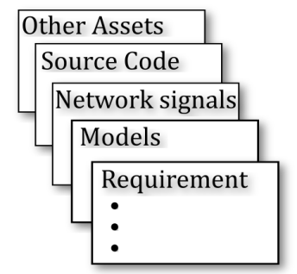
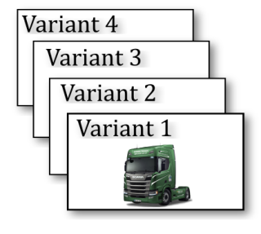
Reverse Engineering in PL context
Features
Feature Diagram
Feature-Asset Dependencies
Different Formulas
Extraction
Family/Domain/150% Model
?
A family model is highly relevant for:
Impact analysis
Enables formal traceability and consistency checking w.r.t. configs
Analyzing compliance with standardized practices
Notes:
In the reverse engineering research, one strats with the assets or product variants, applies the extraction algorithm and on the other side we get either explicit features or exlplicit feature-asset dependencies or an annotated family model.

Slide 3
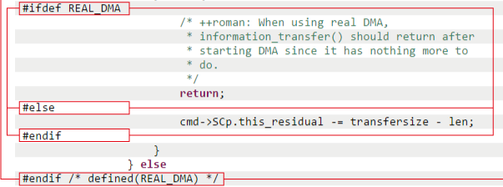
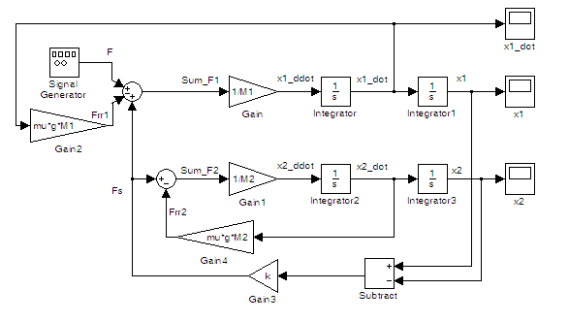
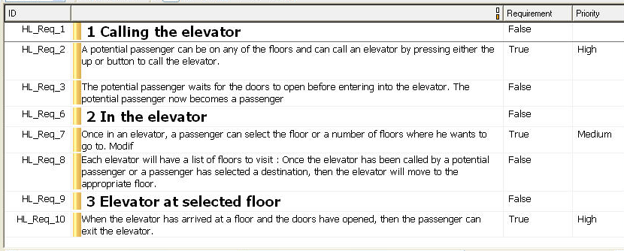
Formalism for representing family models
A family model of a particular type of asset can be represented using formalisms suitable for that type of asset.
What is the appropriate formalism for a family model that can capture all types of assets, their relations, and presence conditions?
How to construct this model without introducing new tools, processes etc.

Slide 4
Formalism for representing family models
Desired properties of such formalism:
General purpose
Expressive enough
Clear (preferably formal) semantics
”existing modeling techniques such as UML were not suitable for this purpose”*
”Using pure::variants Across The Product Line Lifecycle. D. Beuche, R. Hellebrand, in proceedings of SPLC’17”

Slide 5
Difficulties with traditional modeling
Truck
assembledBy
Employee
SN:String
contractNo:Int
Model Level
instanceOf
instanceOf
:truck
assembledBy
:Sven
SN=”ab123x”
contractNo=57
Real things

Slide 6
Difficulties with traditional modeling
ProductType
createdBy
Employee
Meta-Model Level
SN:String
contractNo:Int
assembledBy
instanceOf
Truck
instanceOf
Model Level
SN:String
createdBy
instanceOf
instanceOf
:truck
:Sven
Real things
SN=”ab123x”
contractNo=57

Slide 7

Difficulties with traditional modeling
ProductType
createdBy
Employee
Meta-Model Level
contractId:Int
instanceOf
Truck
assembledBy
EmployeeInstance:Instance
instanceOf
Model Level
SN:String
contractNo=57
instanceOf
createdBy
:truck
assembledBy
:Sven
Real things
SN=”ab123x”
contractNo=57
Notes:
If you push this up, you have entered language engineering but you want is only to express your data
Truck

Slide 8
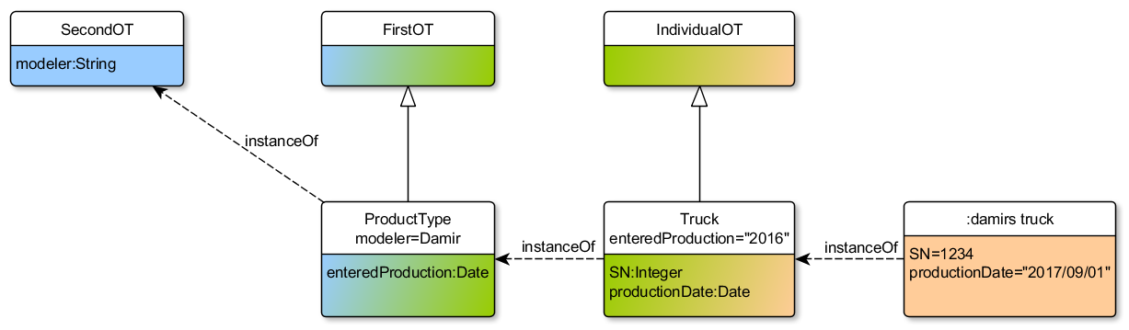
Multi Level conceptual Theory (MLT)
hasAttribute (SecondOT, modeler, String)
iof (ProductType, SecondOT)
specialization (ProductType, FirstOT)
hasAttribute (ProductType, enteredProduction, Date)
isMandatoryAttribute (enteredProduction)…
*Toward a well-founded theory for multi-level conceptual modeling. V. Carvalho and J. Almeida in Software and Systems Modeling, 2016
Notes:
There is an emerging area called Multi Level Modeling that treats this issue. I came here directly from Texas where I gave a talk at a Models workshop on MLM and it’s a growing comunity that now entering a standardization phase and tries to offer the best MLM. The particular one that I’m showing here is Multi level Conceptual Theory.
Classes and individuals can have attributes and these can have cardinalities.
Main advantage of MLM is correct semnatics and resilience to change, in other words higher abstraction levels are stable.

Slide 9
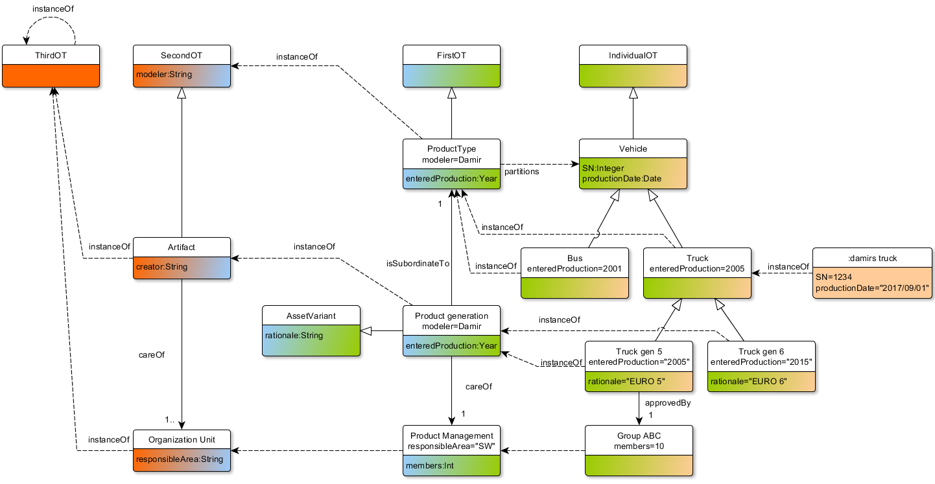
Using Multi Level conceptual Theory (MLT)
Enterprise meta-model
Product Variants
Product variants (meta-) model’
(Product Variants Model’’)
Reusable Assets and other Artifacts
PL concepts
Notes:
Instantiation and specialization are mixed gere explicitly
On top of structural relations MLT also allows introducing different basic relations, e.g. hasPart and it allows defining cardinalities of these relations similar to attributes.

Slide 10
Advantages of using Multi-Level Modeling
Unlimited number of abstraction levels reduce the need to write explicit constraints over the model.
Unlimited number of abstraction levels facilitates separation of concerns and evolution.
Meta-models and models covering different aspects of the product line and also product variants can fit into a single model.
When and How to Use Multilevel Modelling. J. de Lara, E. Guerra, J. S. Cuadrado, TOSEM 2014

Slide 11
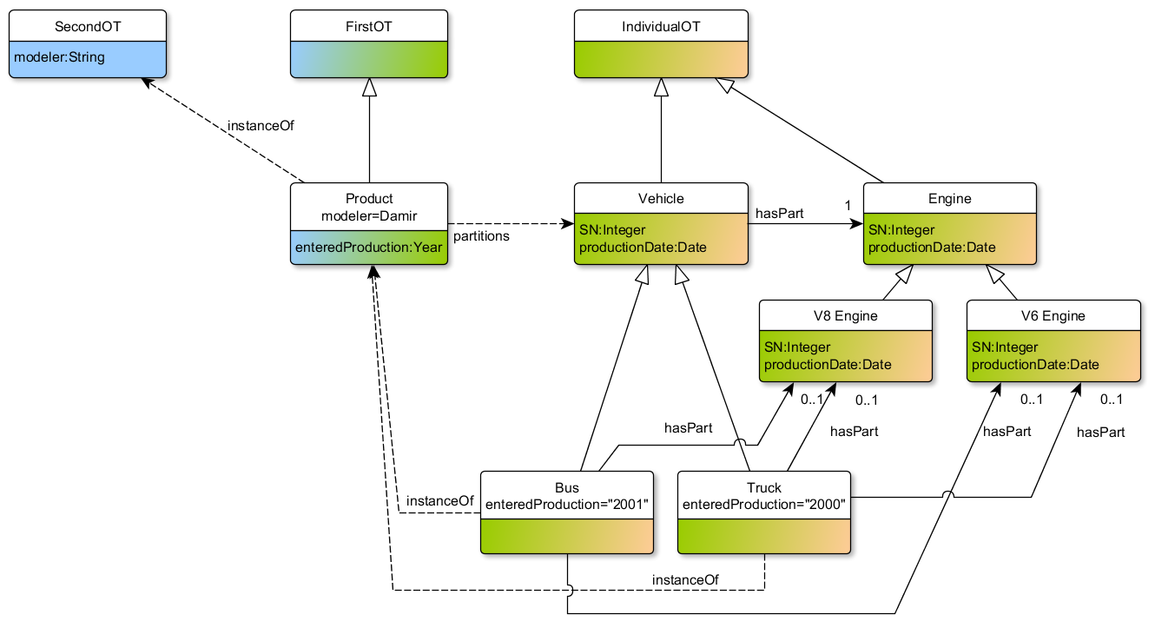
Using Multi Level conceptual Theory (MLT)
Notes:
Off course, just as there are alternatives of features, there are alternatives of parts in the family models. So if we start adding them the situation becomes more complicated because we need to declare which components can a product have (we need a relation) and under which condition does the relation hold (presence condition).
And in MLT we have only classes and relations, so how do we interpret the presence conditions in terms of these?

Slide 12
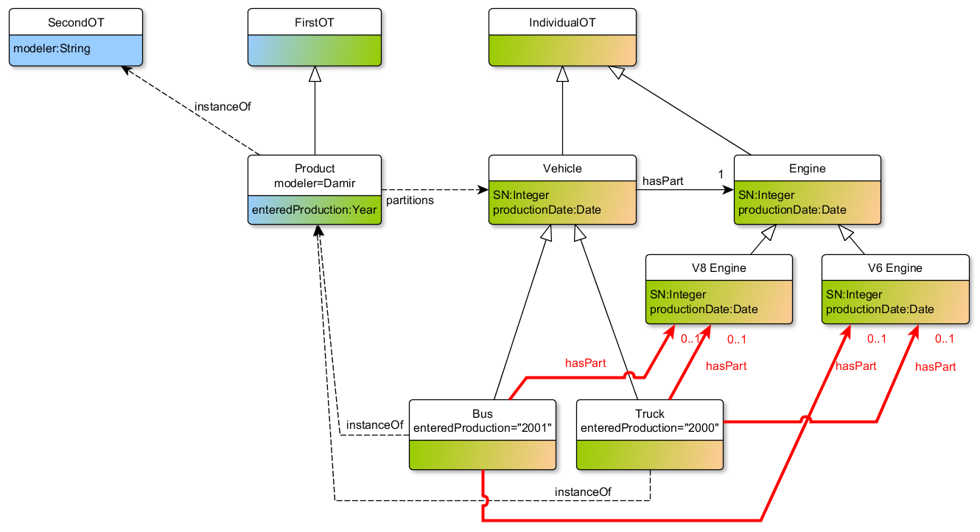
Interpreting Presence Conditions
Product configuration dependent relation
Notes:
We call these relations product configuration specific relations and these relations imply that we can split the the class Truck (in this case) and characterize these two classes.

Slide 13
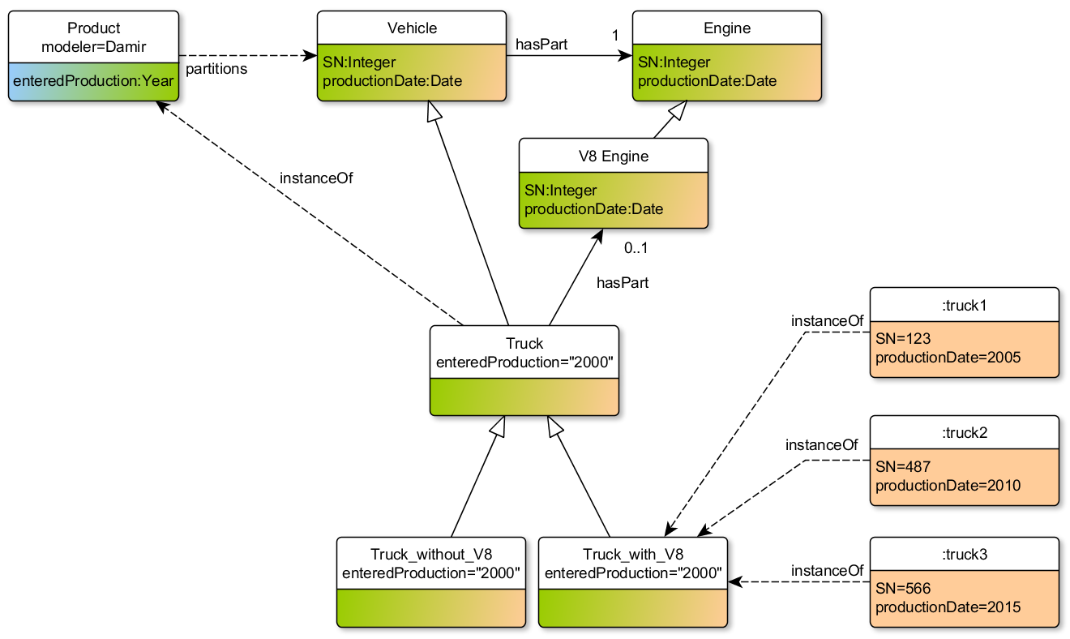
Interpreting Presence Conditions
Φ
c1
c2
c3
Configuration Ci = set of product-describing symbols
Notes:
Prroduct specific relations imply that class that is the source of a PCS can be split into two classes. One class has instances that have a v8 engine and the other one does not. If we assume that the instances that have a v8 are described using various product describing symbols, e.g. features, time validity, other domain specific concepts like parametrs etc., then entailment must hold between the presence condition and any instance description.
It’s not about labeling assets with presence condition but about labeling relations because we don’t have a tree but a graph. Therefore the relation must change the cardinality from 0..1 to 1, i.e. mandatory.

Slide 14
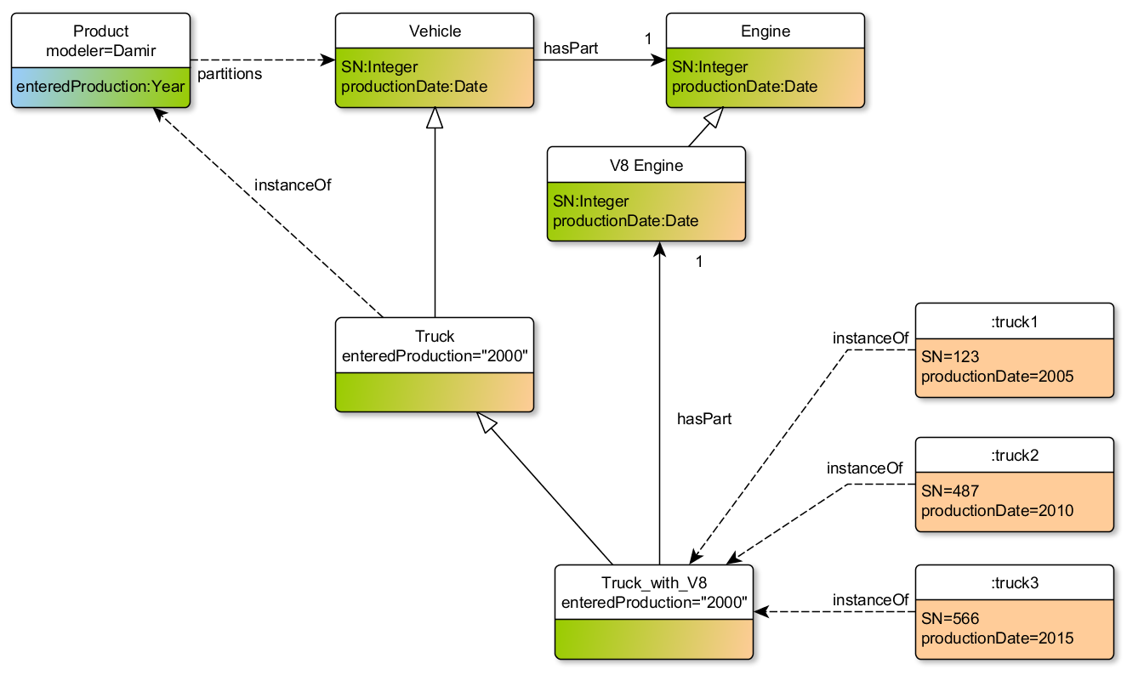
Interpreting Presence Conditions
Product configuration specific relation
Φ
=| c1 ∨ c2 ∨ c3
c1
c2
{c1, c2, c3} ≡
c3
Configuration Ci = set of product-describing symbols
Notes:
Since the class with v8 represent all instances that entail the presence condition, the source end of the PCD relation can be switched to the class truck_with_v8 and then this relation becomes product configuration specific and a mandatory relation. In other words, the presence conditons have an explicit first class representation in the model.

Slide 15
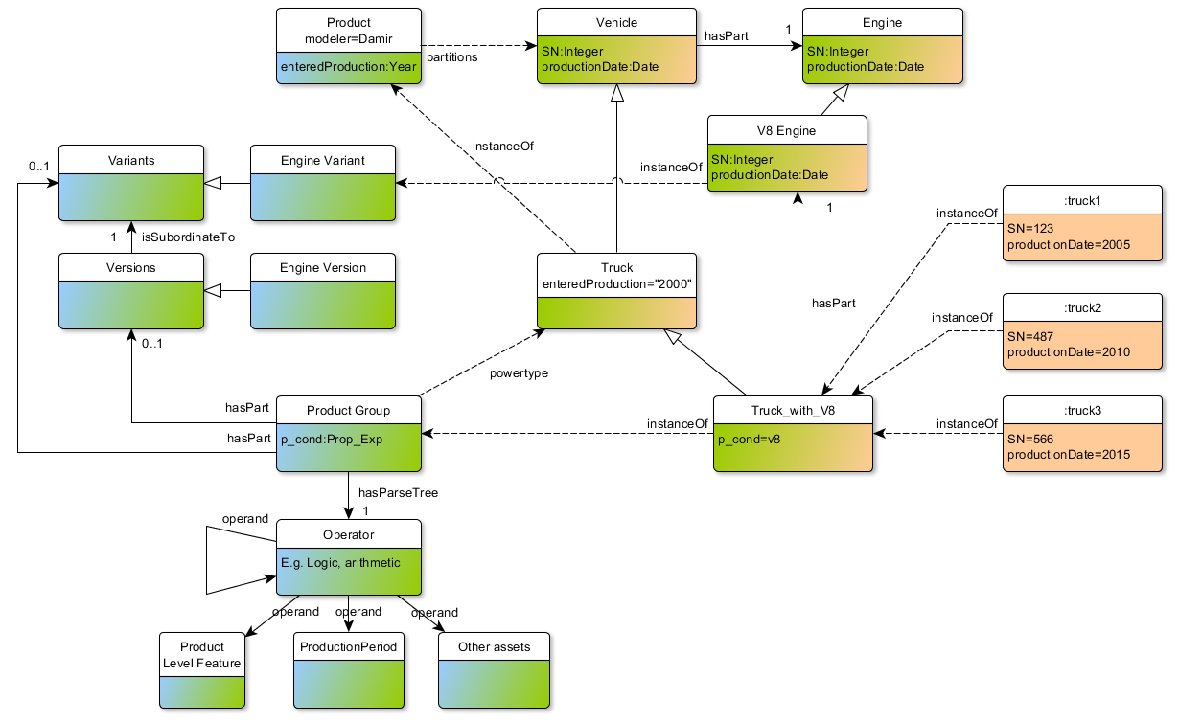
Expressing PLE concepts in MLT
Notes:
All the mentioned concepts like variants of different assets, their versions, presence conditions in different forms can be expressed in the MLT model. Fit structuring of presence conditions here somehow.

Slide 16
Positive aspects of MLT
Syntax and semantics:
Textual syntax and defined (but not implemented) MLT-UML profile for graphical representation
Semantics compatible with semantics in existing analysis tools
Conceptual:
Treats all abstraction levels the same, i.e. gives access to domain knowledge
Pairs of abstraction levels can be viewed as a traditional two-level, models-instance type of model

Slide 17
Conclusions
Evolving and analyzing a Product Line requires a family model covering all relevant aspects in a comprehensible and unambiguous fashion.
This paper presents a framework for integrated management of, but not limited to, different assets and presence conditions*
Unified representation of all assets and presence conditions enables impact analysis, formal traceability, and different (rule) checking.

Slide 18
Future Work
Linked Data supports the idea of an unlimited number of abstraction levels where all levels are treated equally.
Future work aims at providing a tool supported methodology for semi-automated creation of MLT-based family models realized as Linked Data (Lyo toolchain**).
Enterprise meta-model
Product variants (meta-) model’
Product Variants
(Product variants model’’)
Reusable Assets and other Artifacts
PL concepts
* Applying Multi Level Modeling to Data Integration in Product Line Engineering. D. Nesic, M. Nyberg in MULTI@MODELS ’17
**A Model-Driven Engineering Approach to Software Tool Interoperability based on Linked Data. J. El-khoury , D. Gurdur, M. Nyberg, Journal On Advances in Software, 2016

